Slide 1
Mojo Menus Design presentation

Slide 2
Main page
Bence Toth

Slide 3
Use case diagram

Slide 4
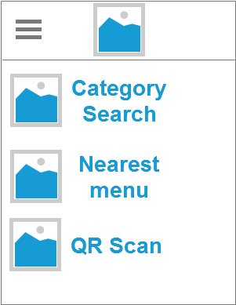
Axure RP Concept
Clean
Simple
Easy to use
Flat Design

Slide 5
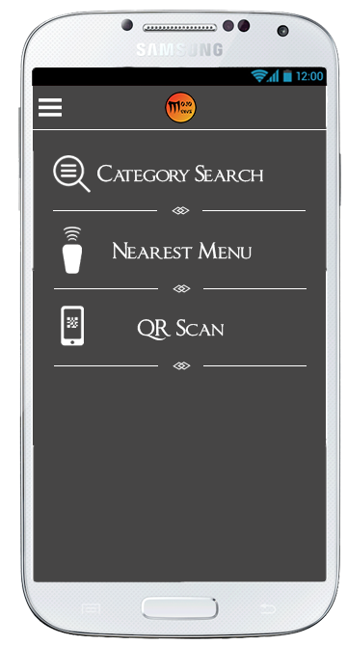
Main concept
Category Search
Nearby Shops
QR Scan

Slide 6
Category search
Kozimjon Khikmatillaev

Slide 7
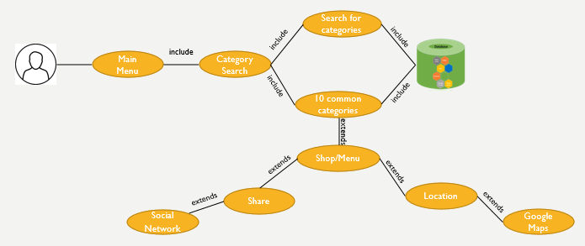
Use case diagram

Slide 8
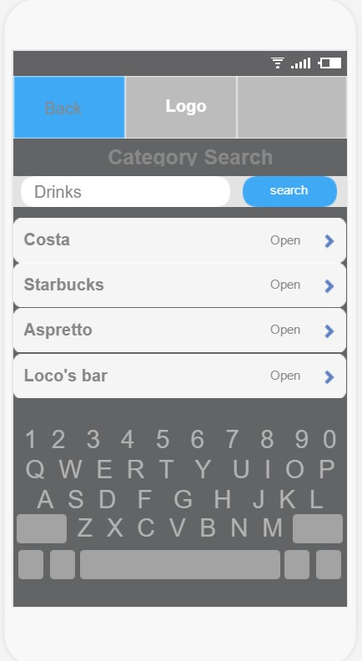
Category search
When a user clicks on “Category Search” from the main menu a drop down menu appears with 10 common categories.
A user also can search for categories instead choosing from the drop down.
After the user chooses a category (drinks) then the app shows the shops from where drinks can be purchased.
If “Back” is clicked it takes to the previous menu

Slide 9
Search by name/postcode
Muhunthan Ravichandran

Slide 10
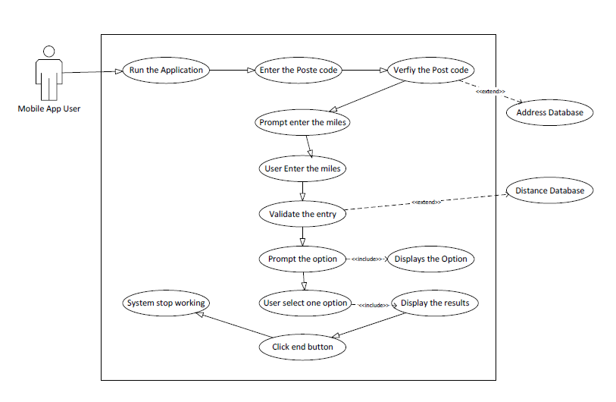
Use case diagram

Slide 11
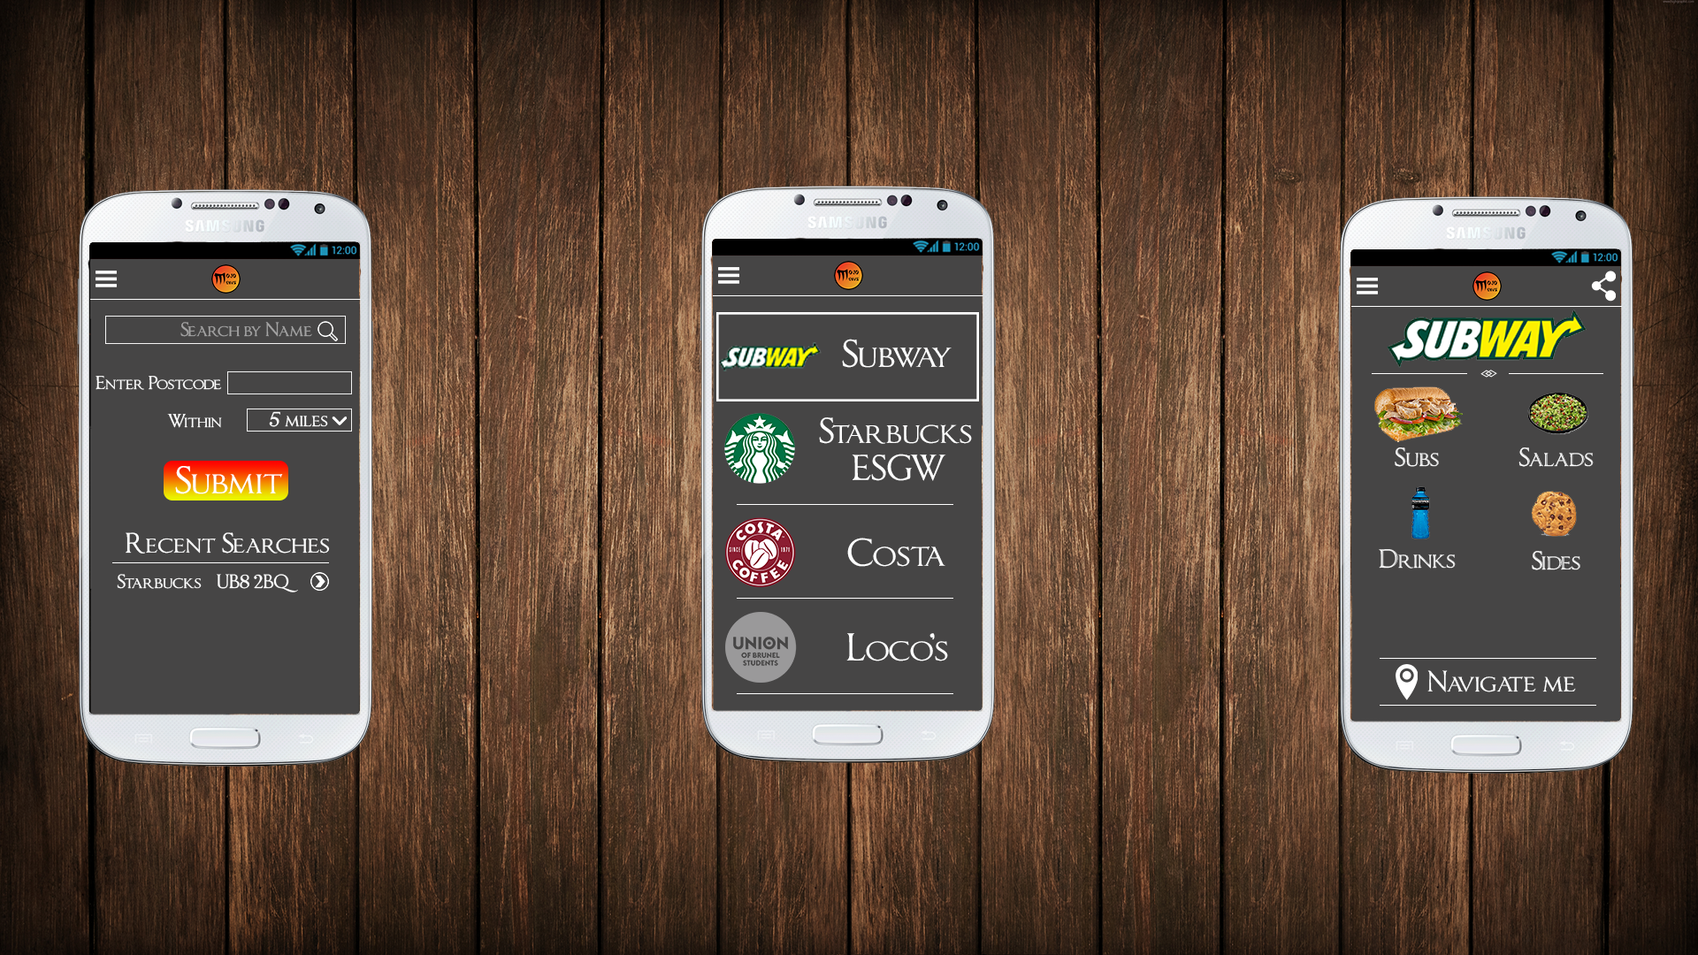
Search By Name/Postcode
Navigation (Menu System)
Company Logo
Search Box
Text field to accept user input
Dropdown list to choose an option
Button to submit the user input
Displays the recent search results
1
2
3
4
5
6
7

Slide 12
List of Stores
1
2
3
Navigation ( Menu System)
Store Logo
Store Name

Slide 13
Example Menus
1
Share button
Store Name
Sub Menu
Navigation to the store
2
3
4

Slide 14
QR SCAN
Minhajul Hussain

Slide 15
QR CODES
Implementation of
Includes
Select Menu
App opens and displays landing page
User Taps Icon
Includes
Includes
User Selects (Scan QR Code)
Select (Scan QR Code)
Scanner goes to link and retrieves data
Scanner decodes and retrieves database link
User scans
QR Code
Scanner opens on the display
Includes
Includes
Includes
Includes
Includes
Key:
Scanner displays information to the user
Displays option to Scan again
Displays option to return to home screen
Includes
Areas within the app.
Above is a Use Case diagram showcasing how QR codes will be used and implemented.

Slide 16
Share Menu
Brenda Puvirajasinghe

Slide 17
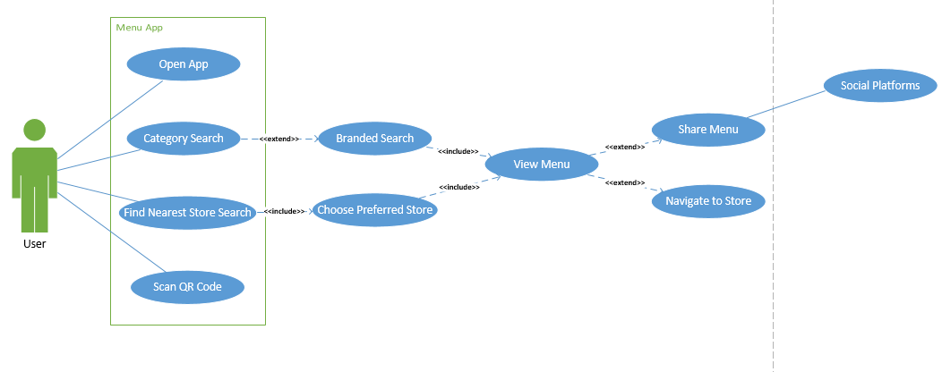
Use case diagram

Slide 18
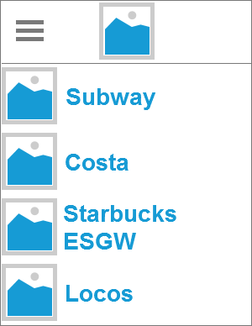
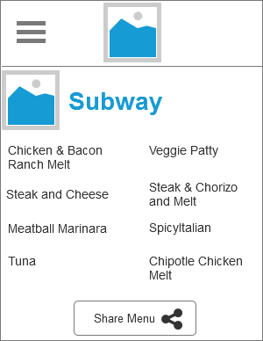
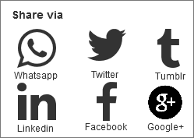
Share menu design using axure rp 8

Slide 19
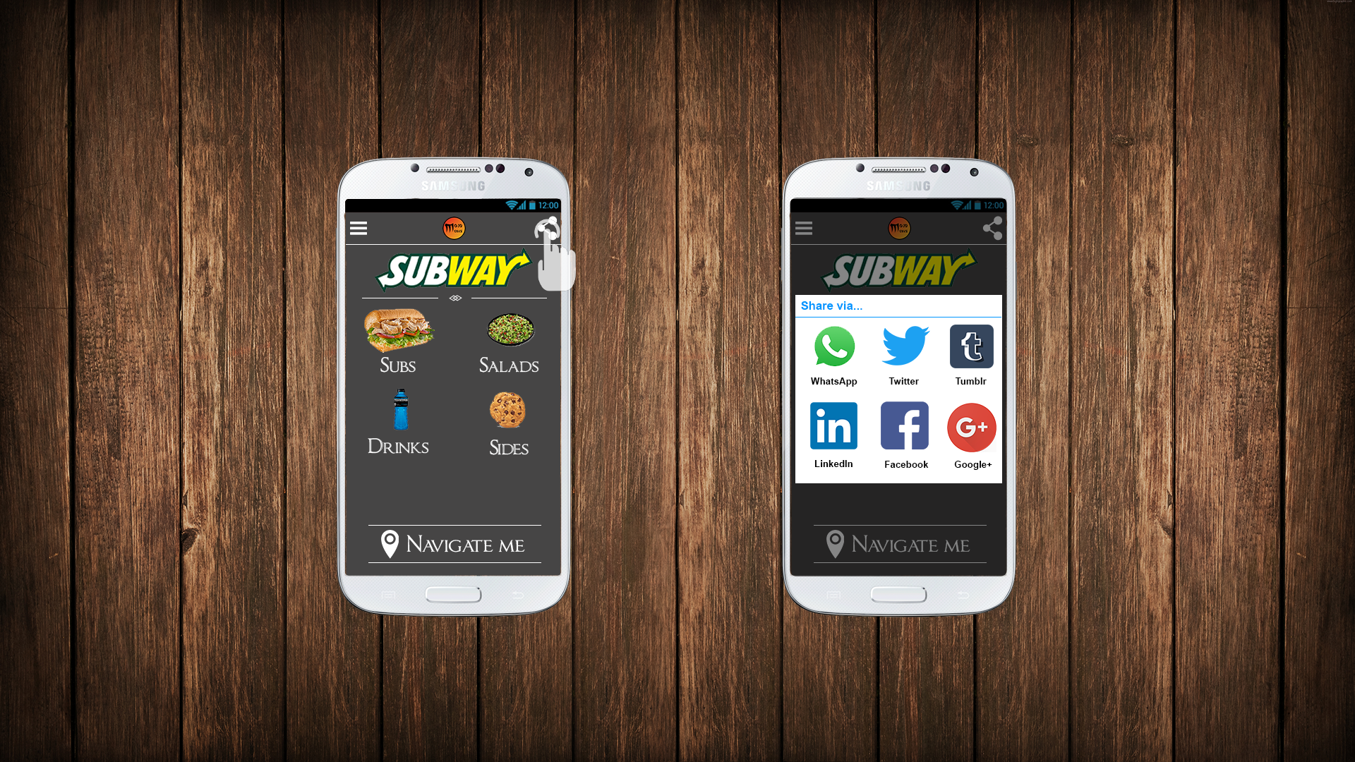
Share menu
E.g. Subway
Menu presented
Share button
Pop up window
Various platforms
Menu shared

Slide 20
Closest Location
Ashwin Khatwa

Slide 21
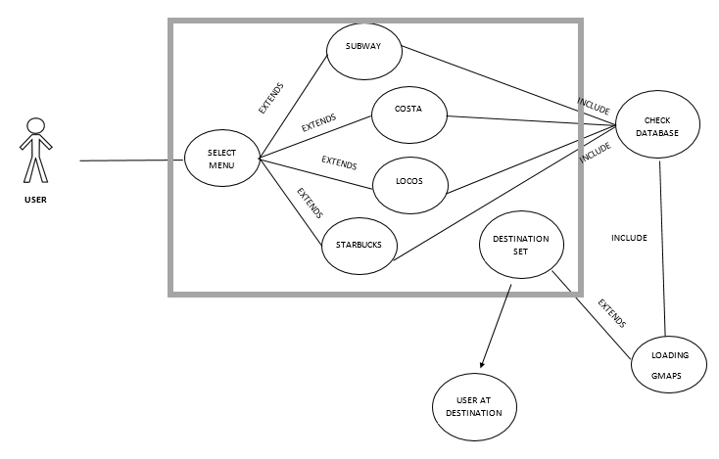
Use case diagram

Slide 22
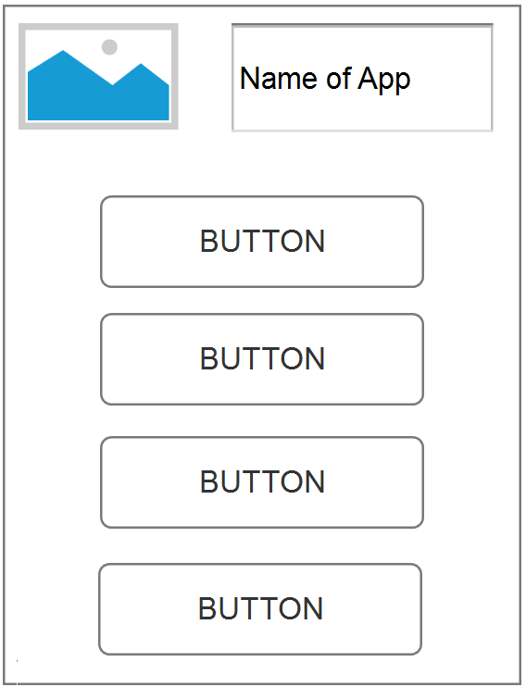
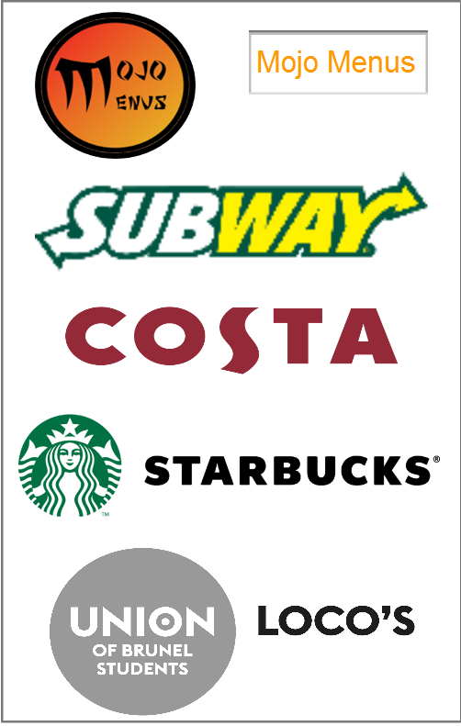
Axure Concept

Slide 23
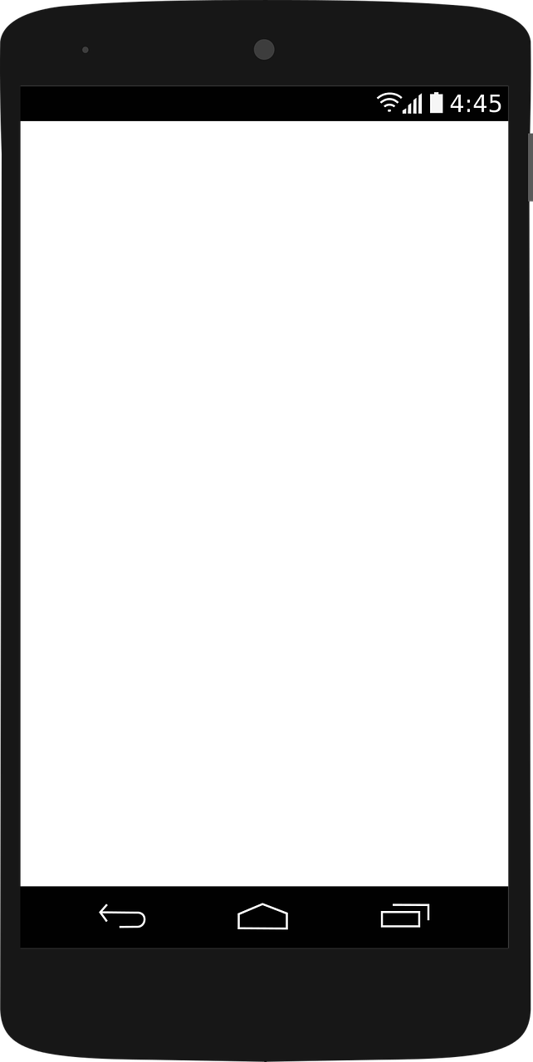
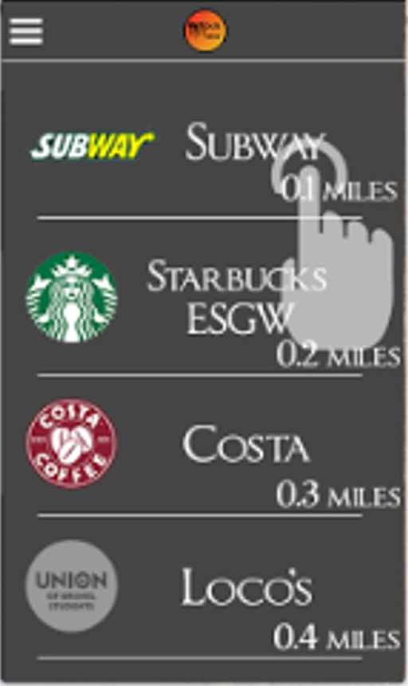
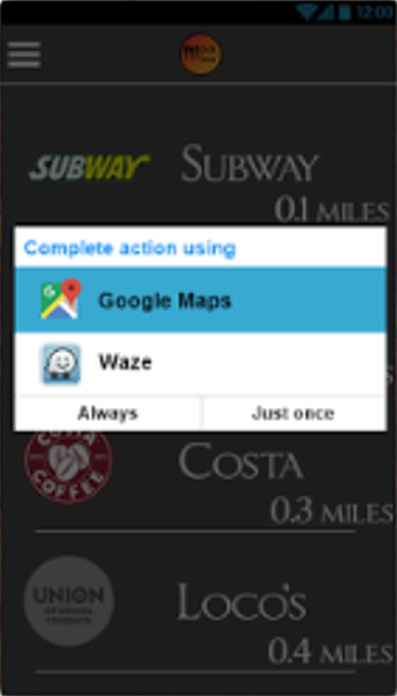
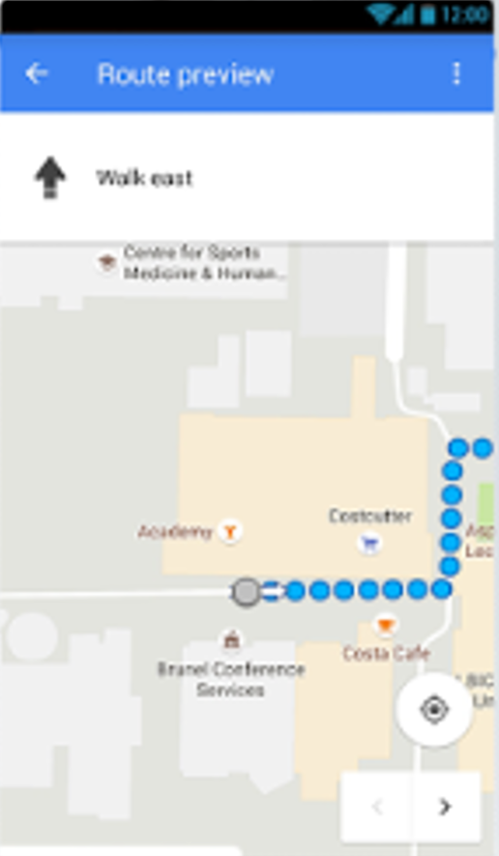
Final Design: Closest location
The user will be taken to their chosen location based app and be given the directions to their chose menu
The user will select which “menu” they want to go to
The closest location will be listed at the top
If the user has more than one location based app they will be given the option which one they like to use

